Slide 1
zhu’ti
陈海斌
Lab of Machine Learning and Data Mining
South China University of Technology

Slide 2
Outline
Part1 强化学习简介、policy gradient
Part2 语义块的选择(词层面)
Learning Structured Representation for Text Classification via Reinforcement Learning(2018 AAAI)
Part3 选择”优秀”的训练样本(句层面)
Reinforcement Learning for Relation Classification from Noisy Data(2018 AAAI)

Slide 3
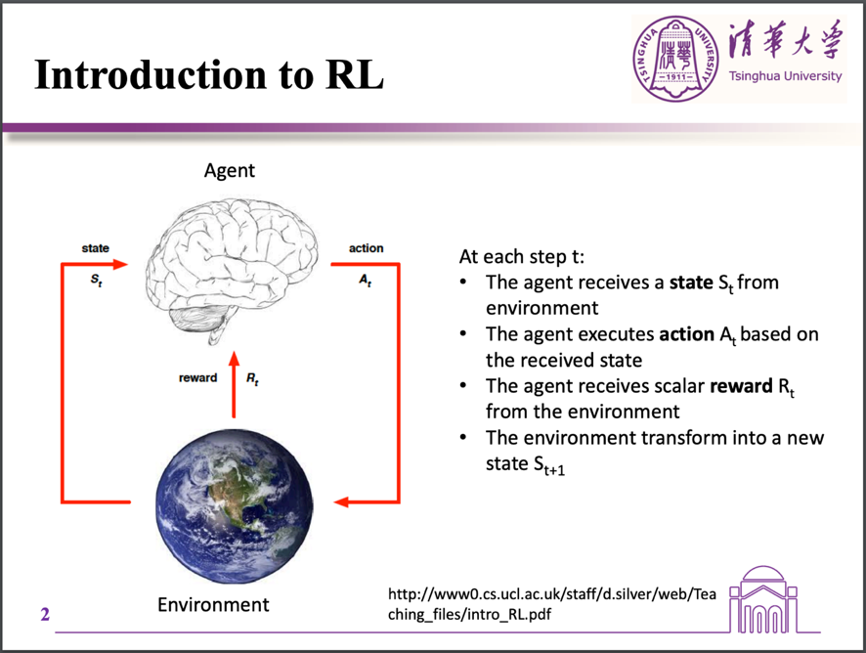
Part1 强化学习

Slide 4
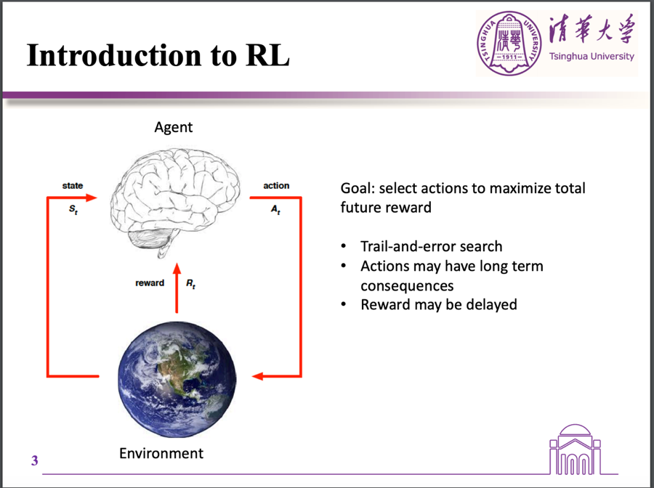
Part2

Slide 5
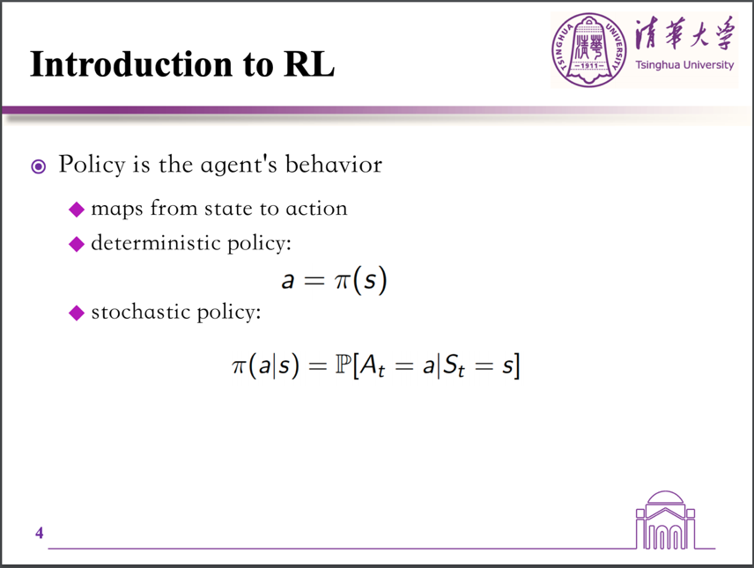
Part2

Slide 6
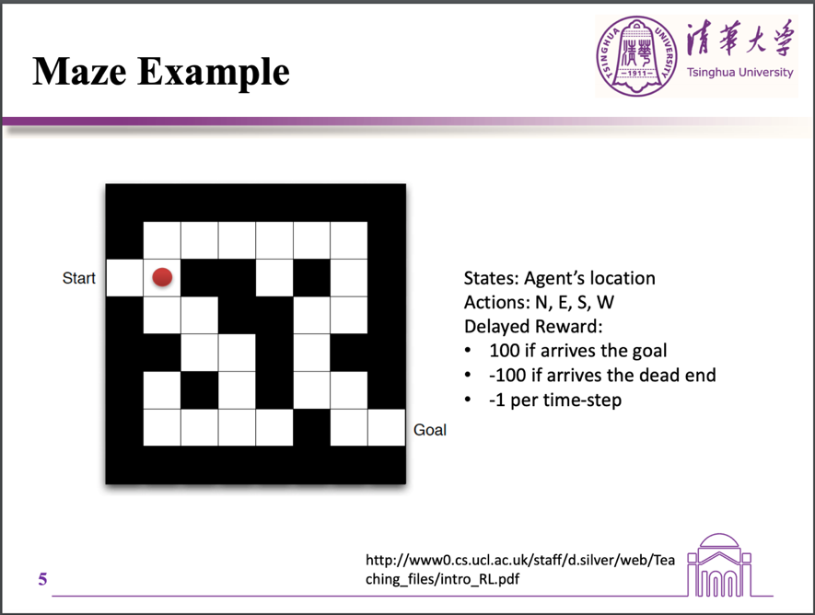
Part2

Slide 7
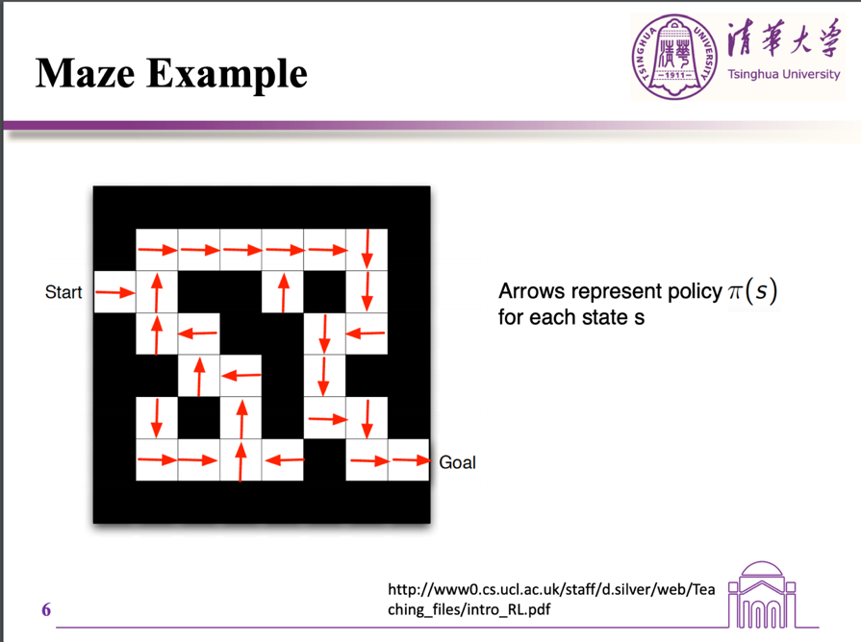
Part2

Slide 8
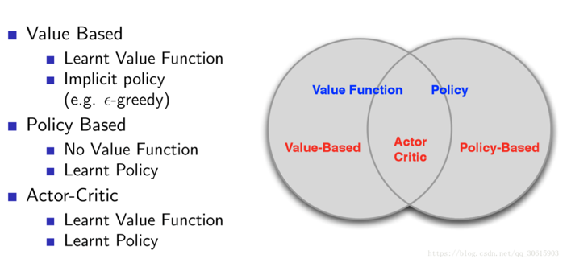
Part1 强化学习
基于模型(有策略)的强化学习：
Value-Based是预测某个State下所有Action的期望价值（Q值），之后通过选择最大Q值对应的Action执行策略，适合仅有少量离散取值的Action的环境
Policy-Based是直接预测某个State下应该采取的Action，适合高维连续Action的环境。它不通过误差反向传播，它通过观测信息选出一个行为直接进行反向传播，利用reward奖励直接对选择行为的可能性进行增强和减弱。

Slide 9
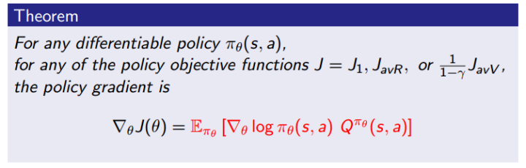
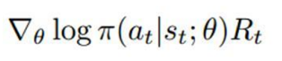
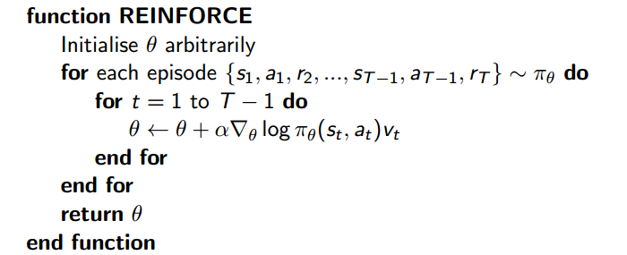
Part2 强化学习
将策略参数化π(a|s,θ)

Slide 10
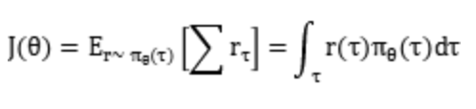
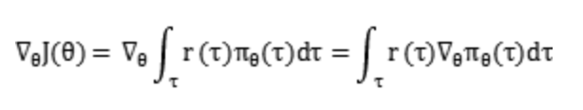
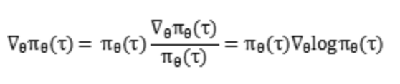
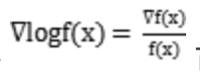
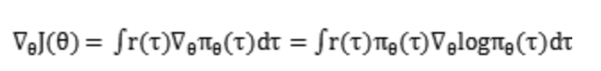
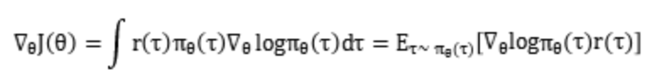
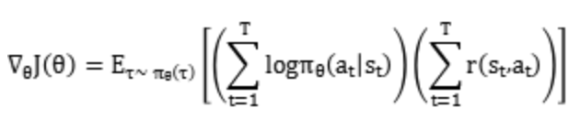
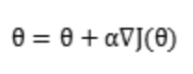
Part2 强化学习
策略梯度方法的梯度更新：
梯度上升
抽样模拟期望，方差大
延迟奖励

Slide 11
Part1 强化学习
论文关注点：
如何在文本序列构建共同训练的强化学习系统
强化学习系统的state、action、delayed reward设计
训练流程(预训练、预处理)

Slide 12
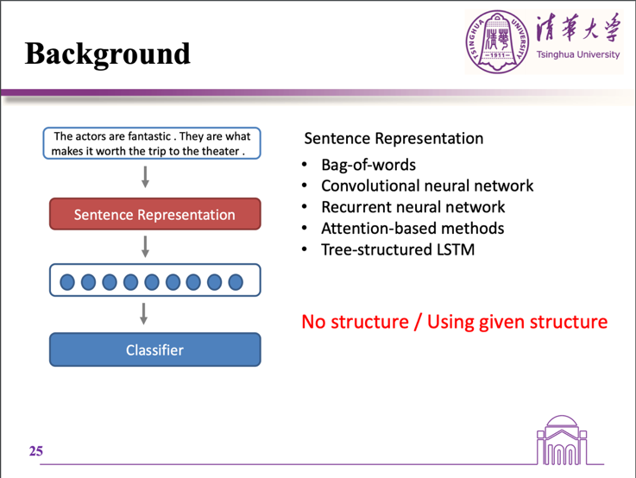
Part2 Learning Structured Representation for Text Classification via Reinforcement Learning

Slide 13
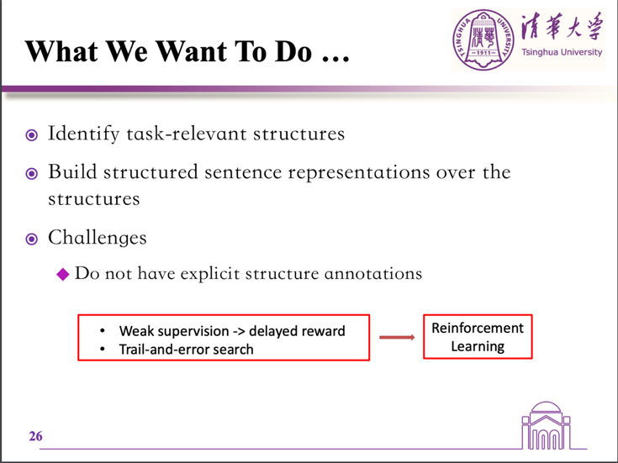
Part2 Learning Structured Representation for Text Classification via Reinforcement Learning

Slide 14
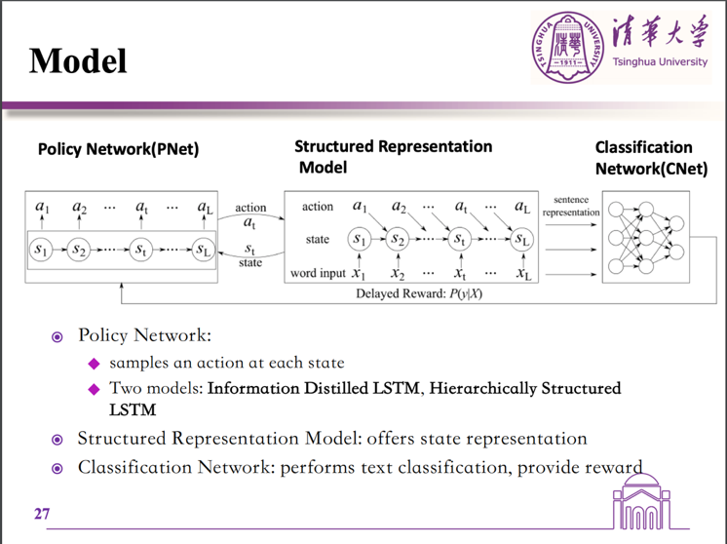
Part2 Learning Structured Representation for Text Classification via Reinforcement Learning

Slide 15
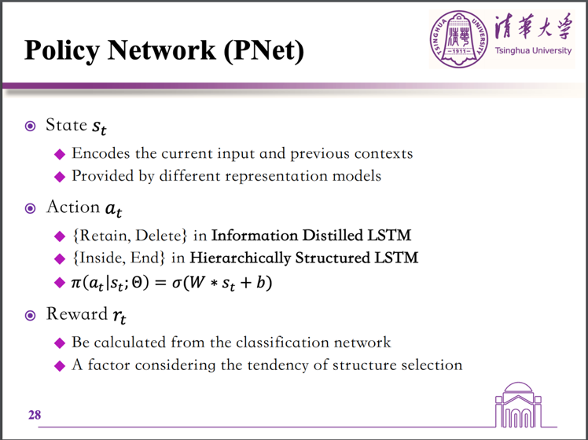
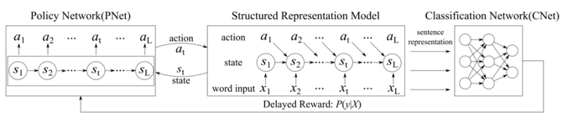
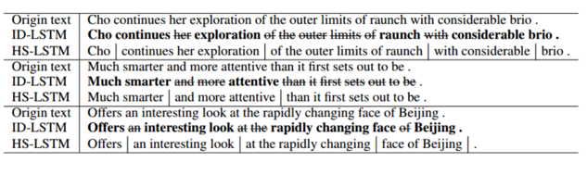
Part2 Learning Structured Representation for Text Classification via Reinforcement Learning

Slide 16
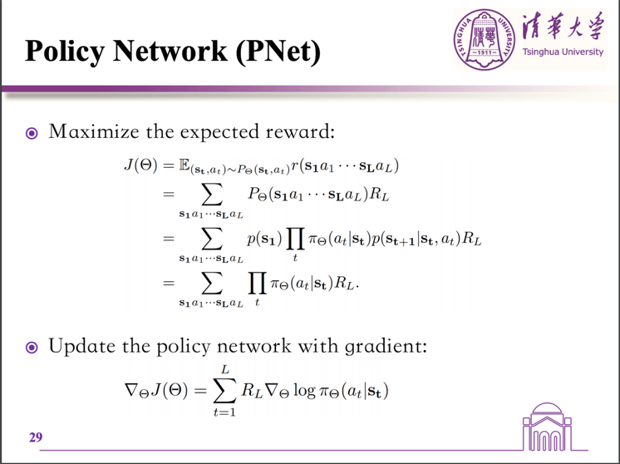
Part2 Learning Structured Representation for Text Classification via Reinforcement Learning

Slide 17
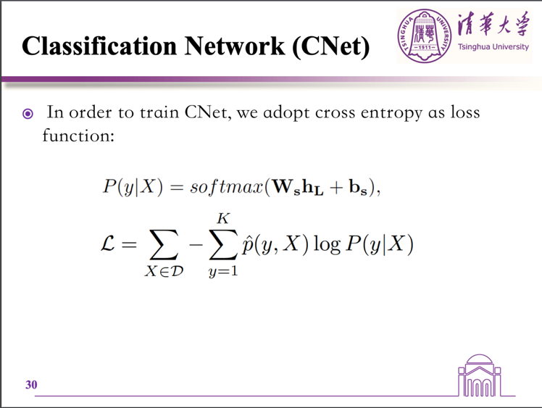
Part2 Learning Structured Representation for Text Classification via Reinforcement Learning

Slide 18
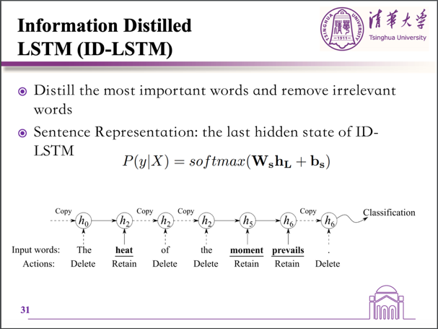
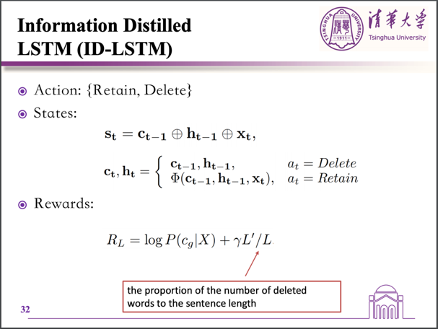
Part2
P(y = cg|X) where cg is the gold label of the inputX
L’/L encourage the model to delete more useless words

Slide 19
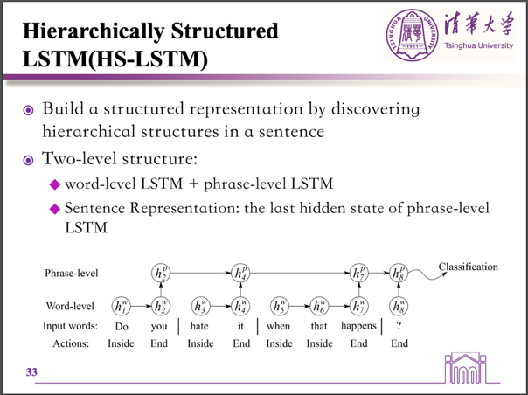
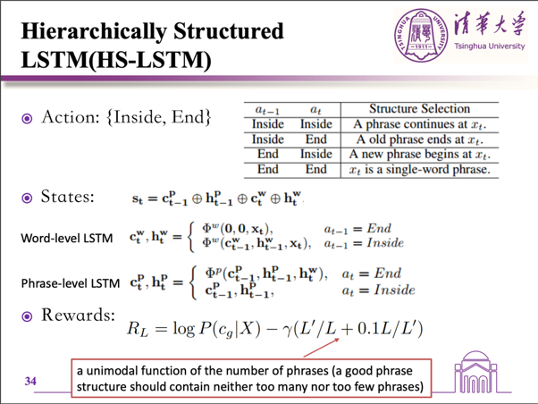
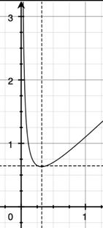
Part2
encourages the number of phrases to be 0.316L, where there are about 3∼4 phrases for L = 10

Slide 20
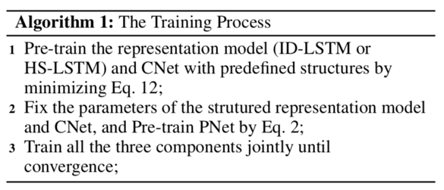
Part2 Learning Structured Representation for Text Classification via Reinforcement Learning
Training detail：
For HS-LSTM, we split a sentence into phrases shorter than the square root of sentence length, and also use some very simple heuristics. 人为的加入训练集的语义块长度

Slide 21
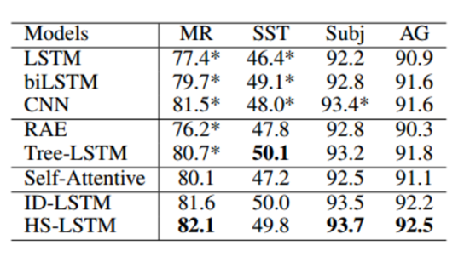
Part2 Learning Structured Representation for Text Classification via Reinforcement Learning

Slide 22
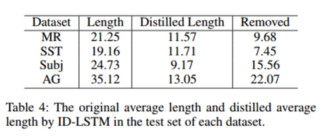
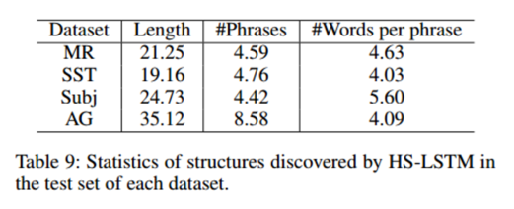
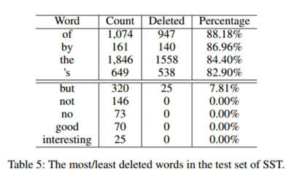
Part2 Learning Structured Representation for Text Classification via Reinforcement Learning

Slide 23
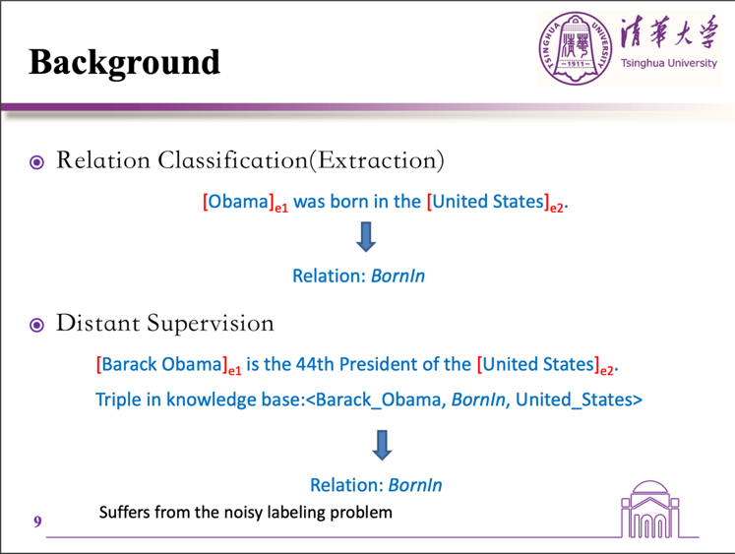
Part3 Reinforcement Learning for Relation Classification from Noisy Data
1.Obtain large scale of training data
2.robust

Slide 24
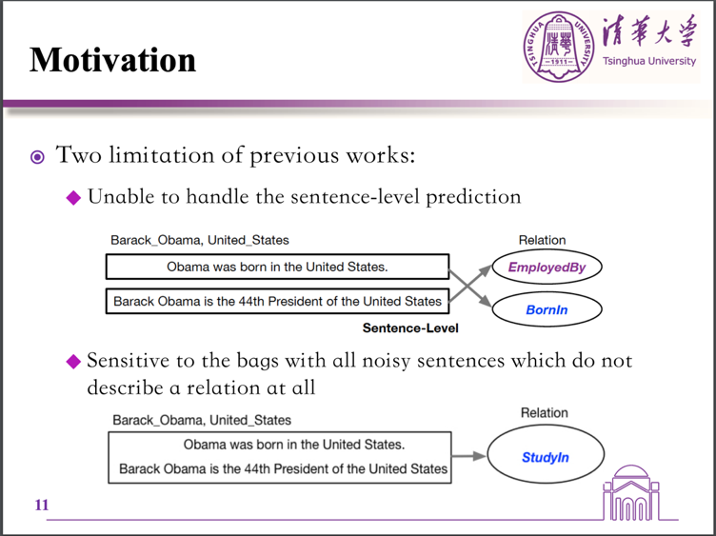
Part3 Reinforcement Learning for Relation Classification from Noisy Data

Slide 25
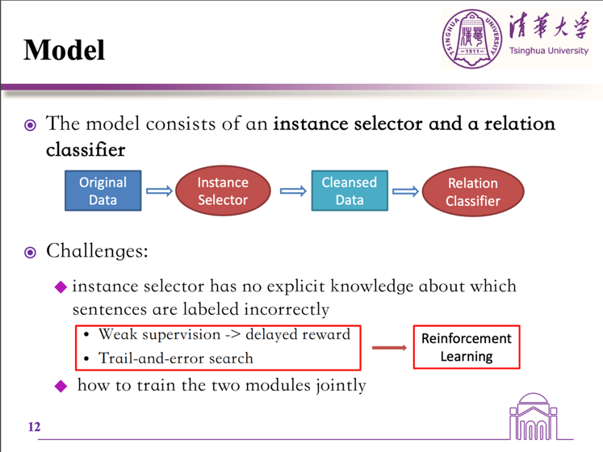
Part3 Reinforcement Learning for Relation Classification from Noisy Data
first, trial-and-error-search, meaning that the instance selector attempts to choose some sentences and obtain feedback (or reward) on the quality of the selected sentences from the relation classifier
second, the feedback from the relation classifier can be obtained only when we finish the instance selection process, which is typically delayed.

Slide 26
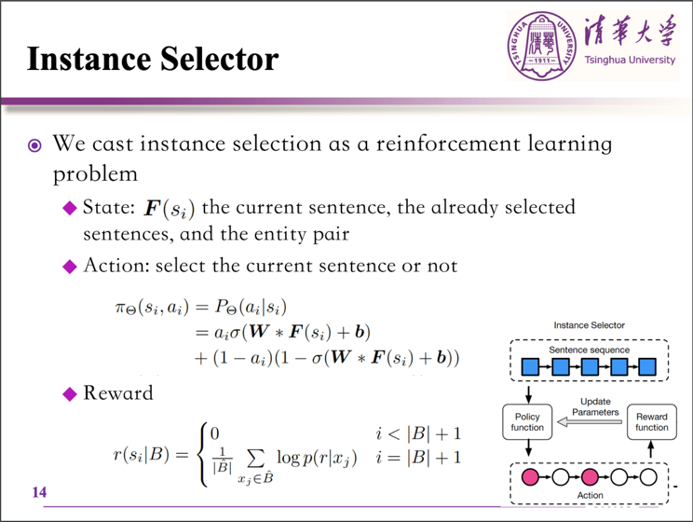
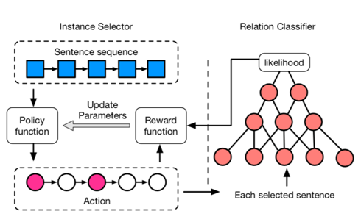
Part3 Reinforcement Learning for Relation Classification from Noisy Data
F(si):
1）当前句子的向量表示，它是从CNN的非线性层获得的;
2）所选句子集的表示，它是所有选择句子(同标签)的向量表示的平均值;
3）从预先训练的知识图嵌入表中获得的两个实体的矢量表示。

Slide 27
Part3 Reinforcement Learning for Relation Classification from Noisy Data
We sample the value of ai by its policy function πΘ (si , ai ), where Θ is the parameters to be learned. In this work, we adopt a logistic function as the policy function
Reward
Bˆ is the set of selected sentences, which is a subset of B, and r is the relation label of bag B.
Delayed reward

Slide 28
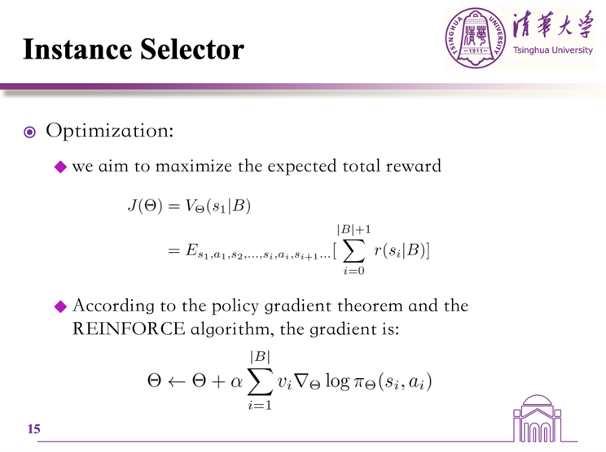
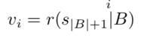
Part3 Reinforcement Learning for Relation Classification from Noisy Data

Slide 29

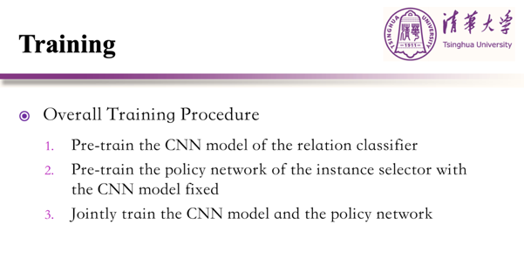
Part3 Reinforcement Learning for Relation Classification from Noisy Data
预训练和训练时：
每个batch都是同一个标签
词向量加入距离实体的position-encoding

Slide 30
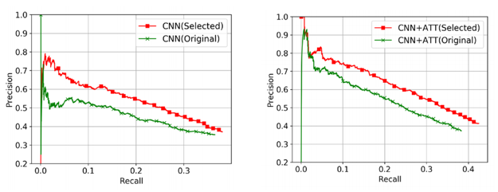
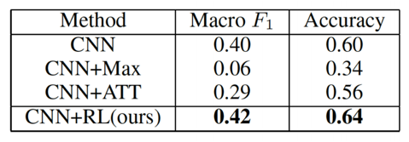
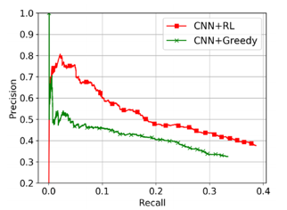
Part3 Reinforcement Learning for Relation Classification from Noisy Data

Slide 31
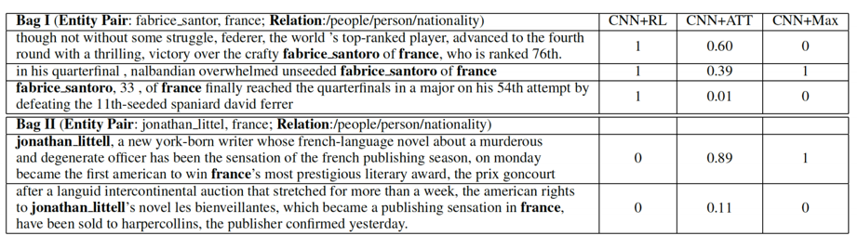
Part3 Reinforcement Learning for Relation Classification from Noisy Data
Contribution:
1.We propose a new model to extract relations at the sentence level on the noisy data.
2.We formulate instance selection as a reinforcement learning problem, just with a weak supervision signal from the relation classifier.
3.Our solution for instance selection can be generalized to other tasks that employ noisy data or distant supervision.

Slide 32


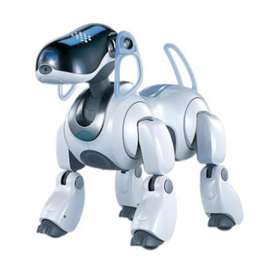
Thanks for your listening ...

